Slide 1

Introducing GitHub

Slide 2
How to install GitHub
Install git(GUI Client)
Install Tortoise Git
Create account Github
*Note: GUI = Graphic User Interface

Slide 3
How to use GitHub
Create a new Git repository
Add an initial codebase to the Git repository
How to upload file into Github
Create Team project
Clone the repository

Slide 4
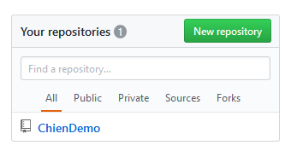
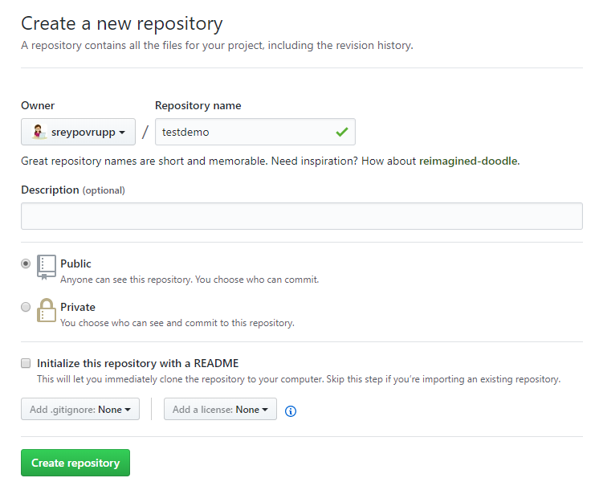
Create a new Git repository
1. 2.

Slide 5
How to upload file into Github
Create folder on github and localhost
By Command line
git init
git add .
git status
git add REAME.md
git commit -m "first commit“
git remote add origin https://github.com/hsreypov/new-test.git
git push -u origin master

Slide 6
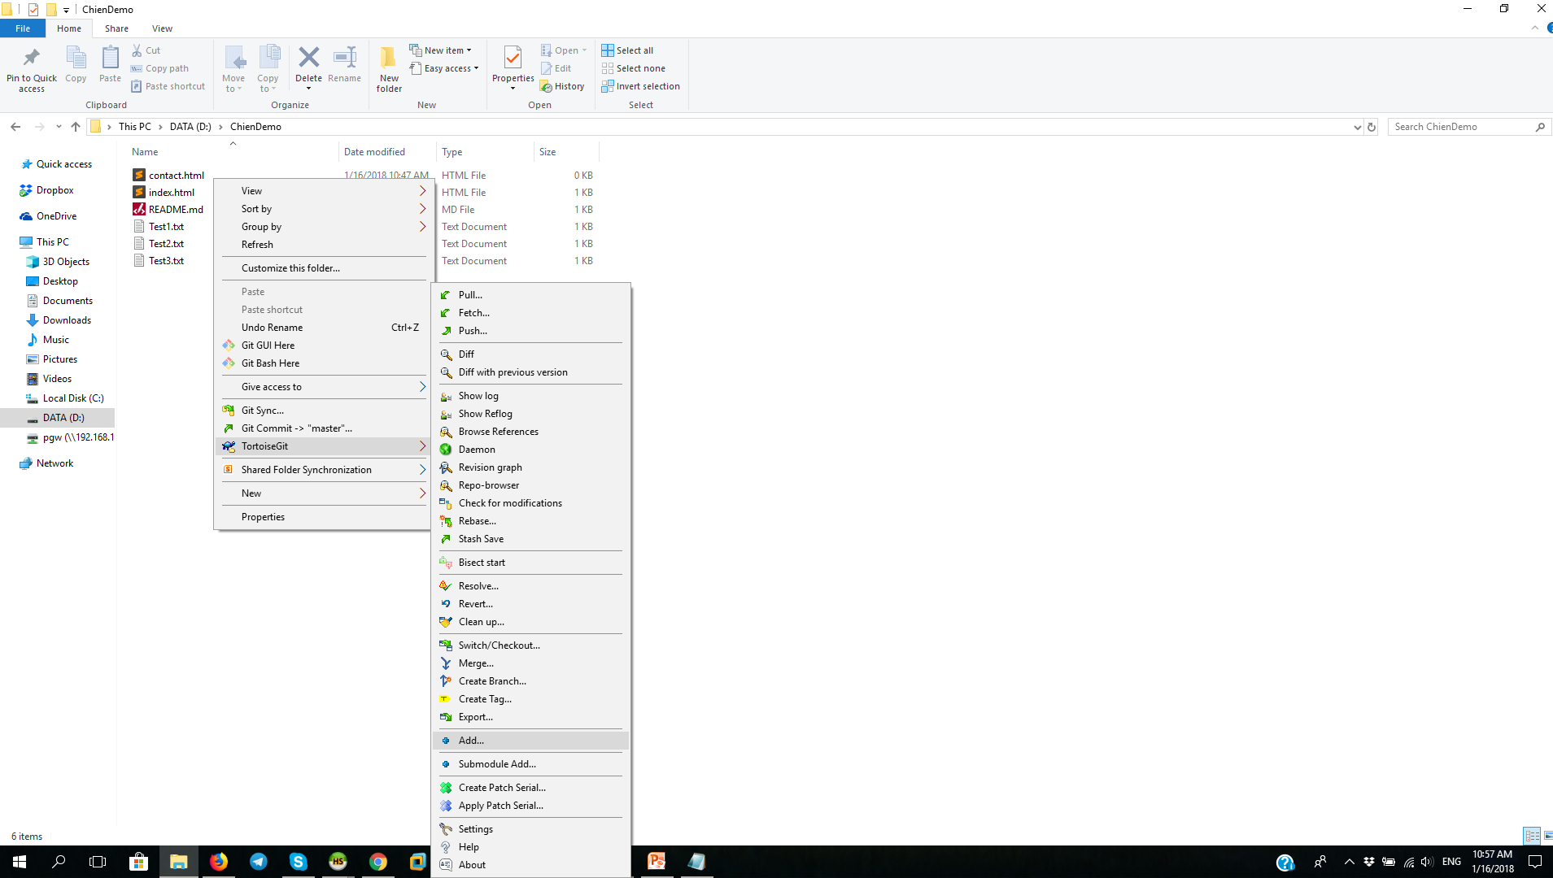
Continue
By GUI

Slide 7
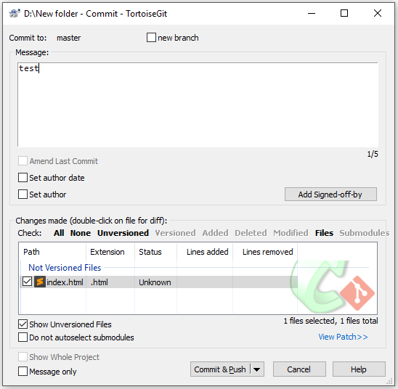
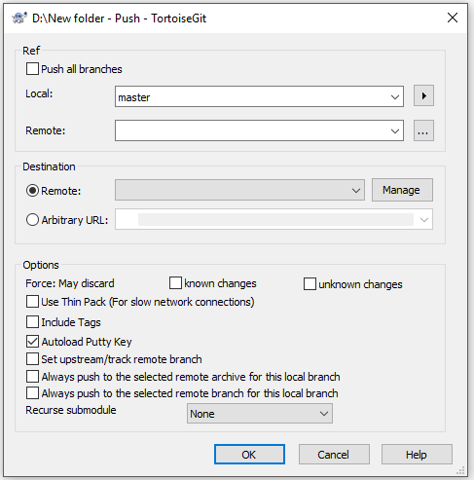
Continue

Slide 8
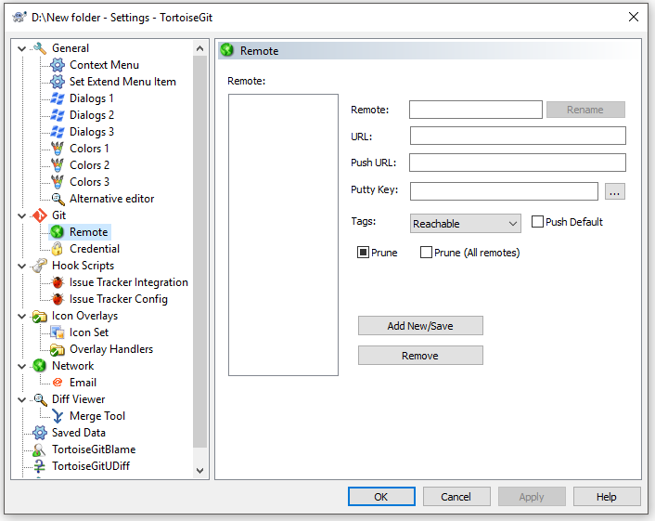
Continue

Slide 9
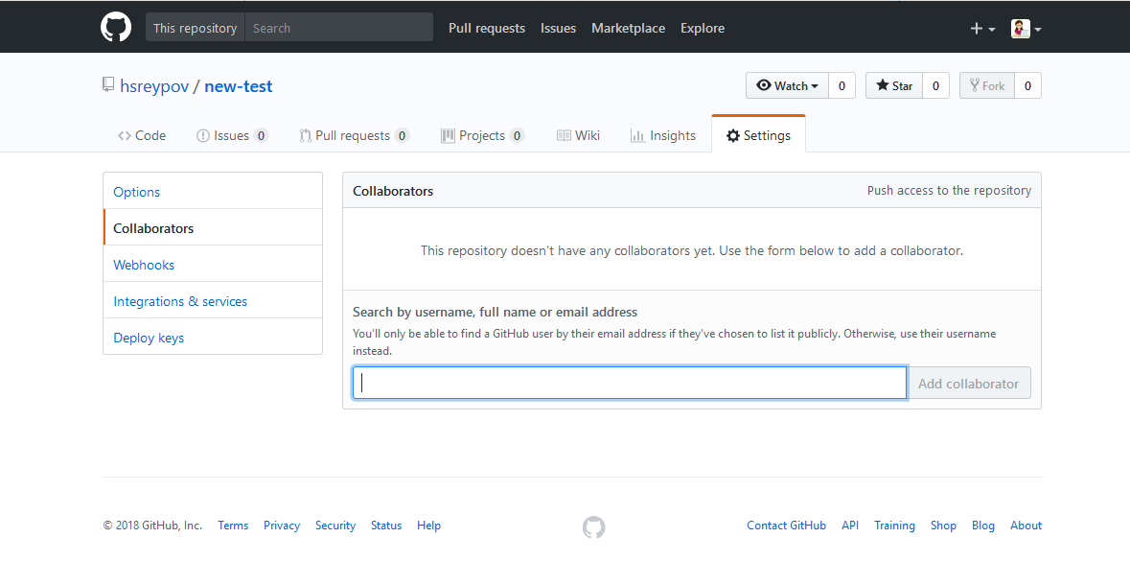
Create Team project

Slide 10
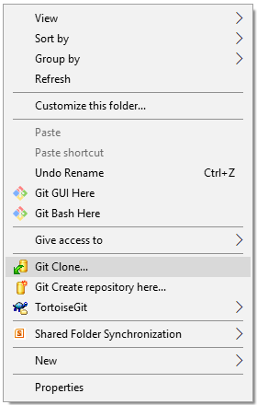
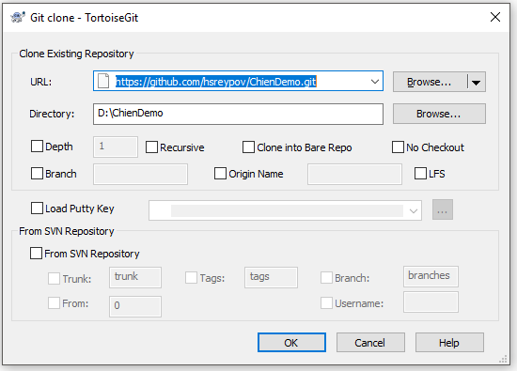
Clone the repository

Slide 11
Q & A

Slide 12
The End

